Slide 1

Intro to Bootstrap
Ranken Technical College

Slide 2
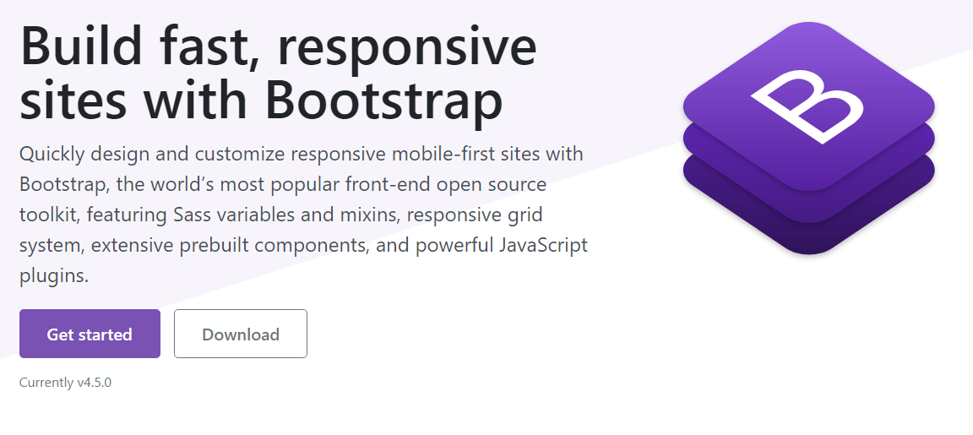
https://getbootstrap.com/

Slide 3




History of Bootstrap
Bootstrap was created at Twitter in 2010 by @mdo (designer) and @fat (developer).
Bootstrap has become one of the most popular front-end frameworks in the world.
Bootstrap has had over 20 releases, include major rewrites for v2, v3, and v4.
Bootstrap has made it much easier to build responsive websites.
Source
https://getbootstrap.com/docs/4.5/about/overview/#history

Slide 4
Key Benefits of Bootstrap
Quick Startup
Mobile-First
Responisive Design
Themes

Slide 5
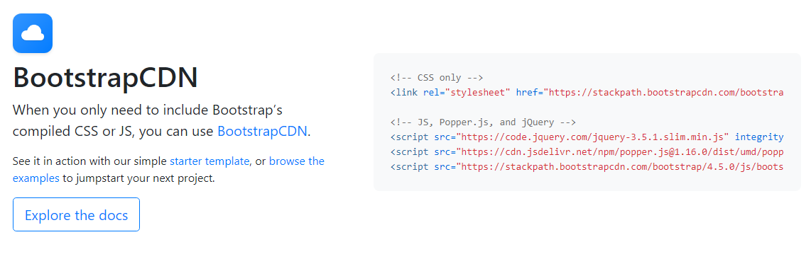
https://getbootstrap.com/docs/4.5/getting-started/download/

Slide 6
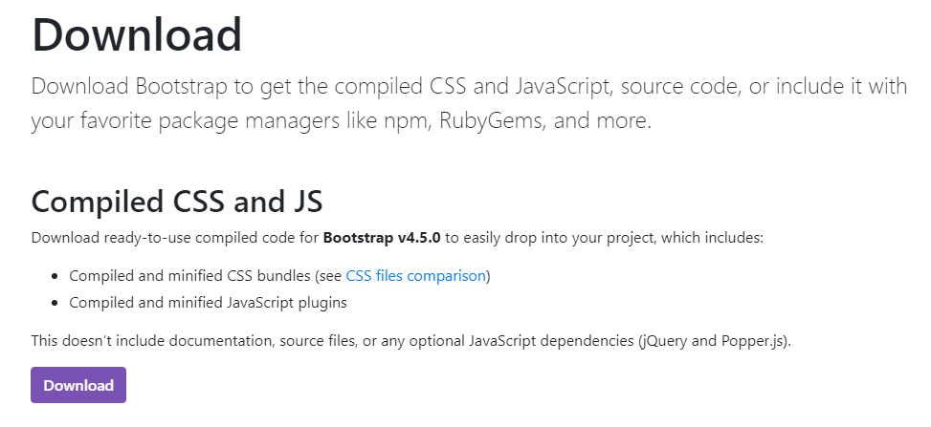
https://getbootstrap.com/docs/4.5/getting-started/download/

Slide 7
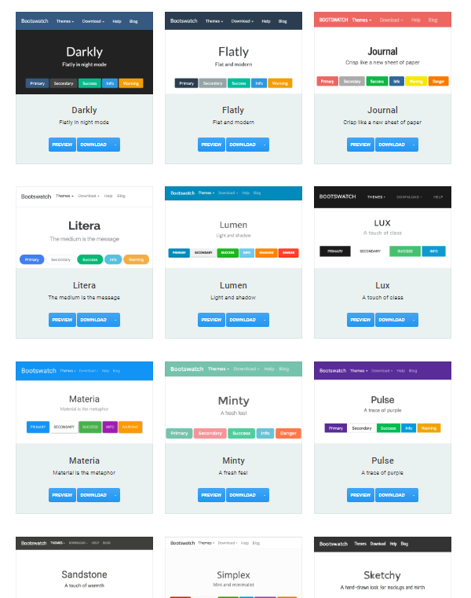

https://bootswatch.com/

Slide 8
Reboot
"For improved cross-browser rendering, we use Reboot to correct inconsistencies across browsers and devices while providing slightly more opinionated resets to common HTML elements."
"Reboot builds upon Normalize, providing many HTML elements with somewhat opinionated styles using only element selectors."
You don't need to include a separate CSS Reset or Normalize.css file.
With Bootstrap it's already built in.
Sources
https://getbootstrap.com/docs/4.5/getting-started/introduction/#reboot
https://getbootstrap.com/docs/4.5/content/reboot/

Slide 9
Installation
Installing Bootstrap from a CDN

Slide 10
Bootstrap CSS via CDN
<link rel="stylesheet"
href="https://stackpath.bootstrapcdn.com/bootstrap/4.5.0/css/bootstrap.min.css"
integrity="sha384-9aIt2nRpC12Uk9gS9baDl411NQApFmC26EwAOH8WgZl5MYYxFfc+NcPb1dKGj7Sk"
crossorigin="anonymous">
Sources
https://getbootstrap.com/docs/4.5/getting-started/download/

Slide 11
Bootstrap JS via CDN
<script src="https://code.jquery.com/jquery-3.5.1.min.js"
integrity="sha256-9/aliU8dGd2tb6OSsuzixeV4y/faTqgFtohetphbbj0="
crossorigin="anonymous"></script>
<script src="https://cdn.jsdelivr.net/npm/popper.js@1.16.0/dist/umd/popper.min.js"
integrity="sha384-Q6E9RHvbIyZFJoft+2mJbHaEWldlvI9IOYy5n3zV9zzTtmI3UksdQRVvoxMfooAo"
crossorigin="anonymous"></script>
<script src="https://stackpath.bootstrapcdn.com/bootstrap/4.5.0/js/bootstrap.min.js"
integrity="sha384-OgVRvuATP1z7JjHLkuOU7Xw704+h835Lr+6QL9UvYjZE3Ipu6Tp75j7Bh/kR0JKI"
crossorigin="anonymous"></script>
* Get the full version of jQuery,
not the slim version!
Sources
https://getbootstrap.com/docs/4.5/getting-started/download/
https://code.jquery.com/

Slide 12
Breakpoints
Responsive Design with Media Queries

Slide 13
How wide is your viewport?
Bootstrap uses some predefined breakpoints and media queries to help you build responsive websites.
Name | Abbreviation | Viewport Width
Extra Small | xs | ≥ 0px
Small | sm | ≥ 576px
Medium | md | ≥ 768px
Large | lg | ≥ 992px
Extra Large | xl | ≥ 1200px
Source
https://getbootstrap.com/docs/4.5/layout/overview/

Slide 14
Spacing
Responsive Margins & Padding

Slide 15
How much space do you want?
Margin Classes
m-0
m-1
m-2
m-3
m-4
m-5
m-auto
Padding Classes
p-0
p-1
p-2
p-3
p-4
p-5
Source
https://getbootstrap.com/docs/4.5/utilities/spacing/

Slide 16
What side you want it on?
You can apply a different amount of margin to each side using these classes.
m-3 all sides
mt-3 margin-top
mb-3 margin-bottom
ml-3 margin-left
mr-3 margin-right
mx-3 left and right
my-3 top and bottom
You can apply a different amount of padding to each side using these classes.
p-3 all sides
pt-3 padding-top
pb-3 padding-bottom
pl-3 padding-left
pr-3 padding-right
px-3 left and right
py-3 top and bottom
Source
https://getbootstrap.com/docs/4.5/utilities/spacing/

Slide 17
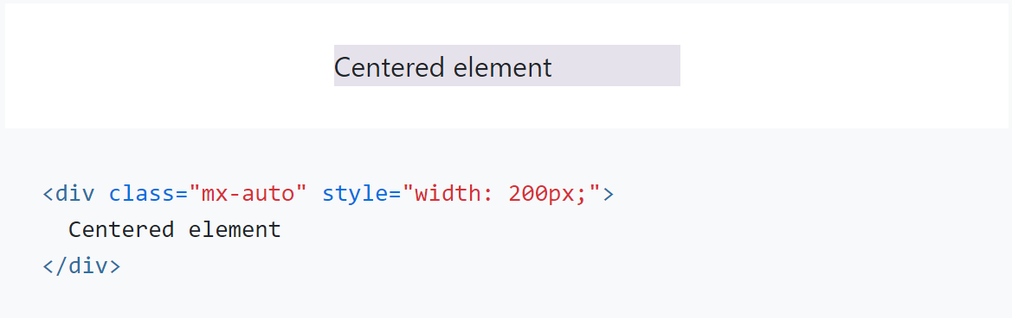
Horizontal Centering
Bootstrap includes an .mx-auto class for horizontally centering fixed-width block level content — that is, content that has display: block and a width set — by setting the horizontal margins to auto.
Source
https://getbootstrap.com/docs/4.5/utilities/spacing/

Slide 18
How wide is your viewport?
You can use breakpoints to change how much margin/padding is applied depending on the width of the viewport.
Example
class="m-0 m-lg-3"
No margin on Extra Small, Small, and Medium screens.
Margin = $spacer on Large and Extra Large screens.
Example
class="m-0 m-md-2 m-lg-3 m-xl-5"
No margin on Extra Small and Small screens.
Margin = $spacer * .5 on Medium screens.
Margin = $spacer on Large screens.
Margin = $spacer * 3 on Extra Large screens.
Name | Abbreviation | Viewport Width
Extra Small | xs | ≥ 0px
Small | sm | ≥ 576px
Medium | md | ≥ 768px
Large | lg | ≥ 992px
Extra Large | xl | ≥ 1200px
Source
https://getbootstrap.com/docs/4.5/utilities/spacing/

Slide 19
Sizing
for fluid layouts

Slide 20
Sizing: Relative to Parent
Use the following classes to set the width property.
.w-25 { width: 25%; }
.w-50 { width: 50%; }
.w-75 { width: 75%; }
.w-100 { width: 100%; }
.mw-100 { max-width: 100%; }
.mh-100 { max-height: 100%; }
Source
https://getbootstrap.com/docs/4.5/utilities/sizing/

Slide 21
Sizing: Relative to Viewport
Use the following classes to set the size of an element relative to the viewport.
.min-vw-100 { min-width: 100vw; }
.min-vh-100 { min-height: 100vh; }
Source
https://getbootstrap.com/docs/4.5/utilities/sizing/

Slide 22
Colors
for a consistent look

Slide 23
Text Color
Use the following classes to change the color of the text.
text-primary
text-secondary
text-success
text-danger
text-warning
text-info
text-light
text-dark
text-muted
text-white
text-primary
text-secondary
text-success
text-danger
text-warning
text-info
text-light
text-dark
text-muted
text-white
Important:
Color palette is defined by theme.
Source
https://getbootstrap.com/docs/4.5/utilities/colors/

Slide 24
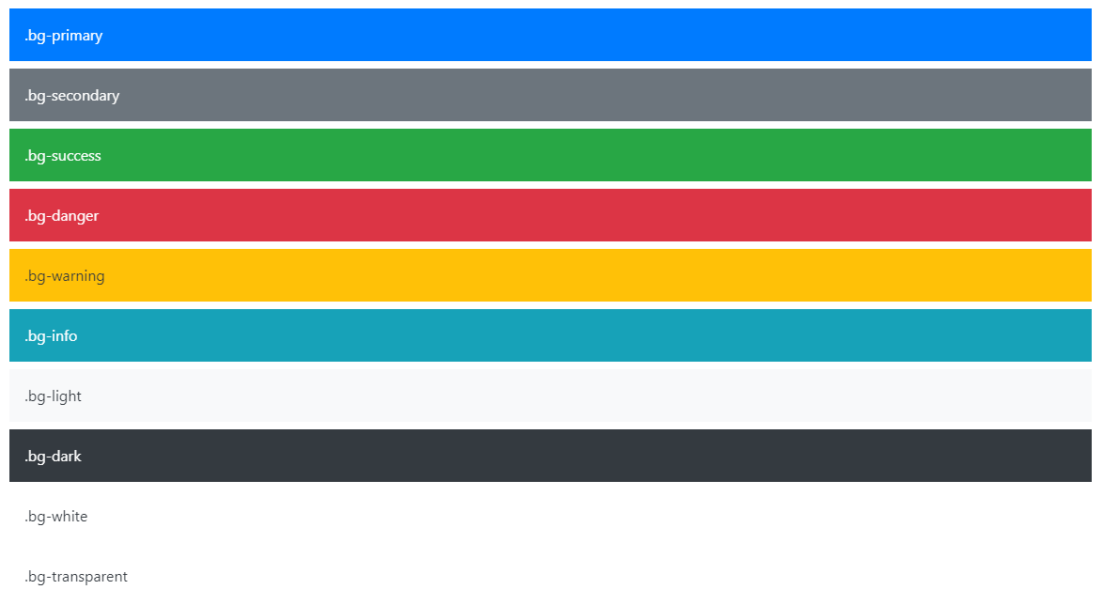
Background Color
Use the following classes to change the background color of an element.
Source
https://getbootstrap.com/docs/4.5/utilities/colors/

Slide 25
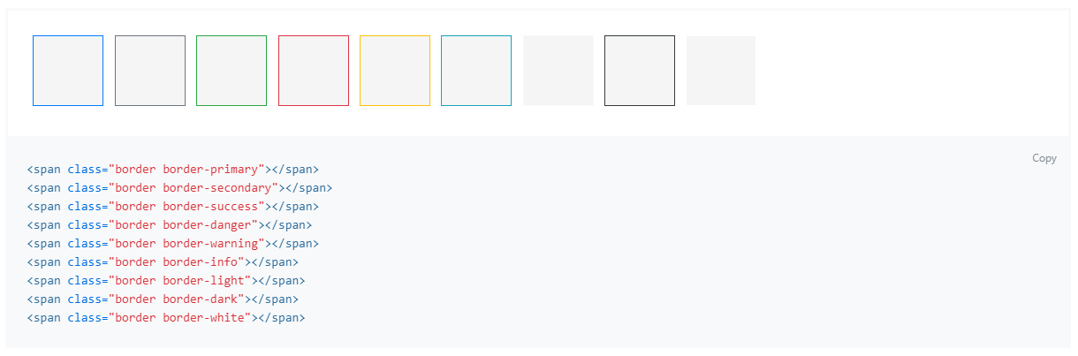
Border Color
Use the following classes to change the border color of an element.
Source
https://getbootstrap.com/docs/4.5/utilities/borders/

Slide 26
Text
quick classes for styling text

Slide 27
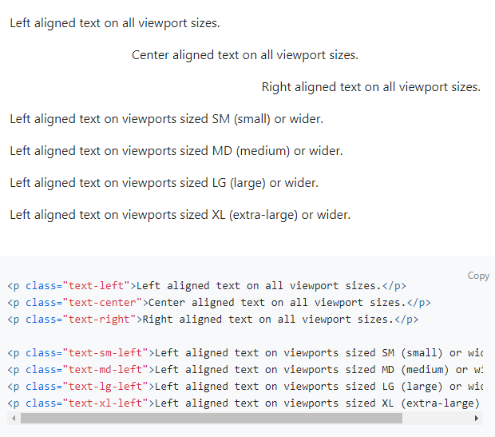
Text Alignment
.text-left { text-align: left; }
.text-center { text-align: center; }
.text-right { text-align: right; }
.text-{breakpoint}-{align}
Source
https://getbootstrap.com/docs/4.5/utilities/text/#text-alignment

Slide 28
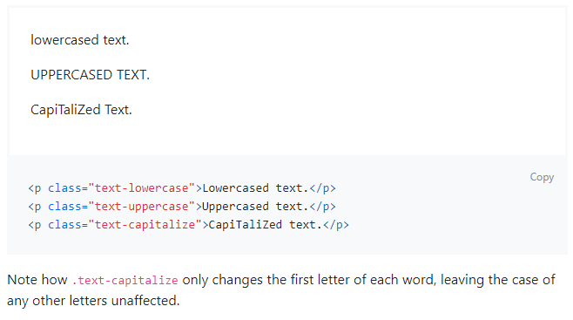
Text Transform
.text-lowercase { text-transform: lowercase; }
.text-uppercase { text-transform: uppercase; }
.text-capitalize { text-transform: capitalize; }
Source
https://getbootstrap.com/docs/4.5/utilities/text/#text-transform

Slide 29
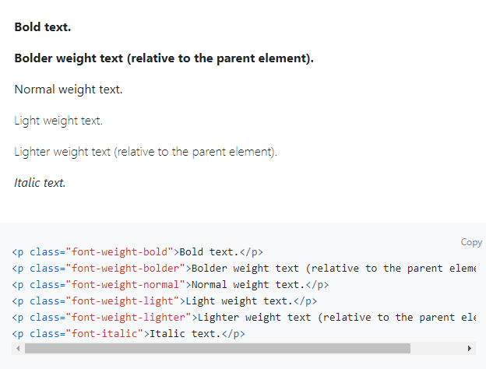
Font Weight and Italics
.font-weight-bold { font-weight: bold; }
.font-weight-bolder { font-weight: bolder; }
.font-weight-normal { font-weight: normal; }
.font-weight-light { font-weight: light; }
.font-weight-lighter { font-weight: lighter; }
.font-italic { font-style: italic; }
Source
https://getbootstrap.com/docs/4.5/utilities/text/#font-weight-and-italics

Slide 30
Flexbox
Responsive Layouts with FlexBox

Slide 31
Display Property
Use the following classes to change the display property.
.d-none { display: none; }
.d-inline { display: inline; }
.d-inline-block { display: inline-block; }
.d-block { display: block; }
.d-flex { display: flex; }
Source
https://getbootstrap.com/docs/4.5/utilities/display/

Slide 32
Display Property with Breakpoints
You can use breakpoints to change how the display property depending on the width of the viewport.
d-{breakpoint}-{display}
Example
class="d-none d-lg-block"
Hidden on Extra Small, Small, and Medium screens.
Visible on Large and Extra Large screens.
Example
class="d-block d-md-flex"
Display = Block on Extra Small and Small screens.
Display = Flex on Medium, Large, and Extra Large screens.
Name | Abbreviation | Viewport Width
Extra Small | xs | ≥ 0px
Small | sm | ≥ 576px
Medium | md | ≥ 768px
Large | lg | ≥ 992px
Extra Large | xl | ≥ 1200px
Source
https://getbootstrap.com/docs/4.5/utilities/display/

Slide 33
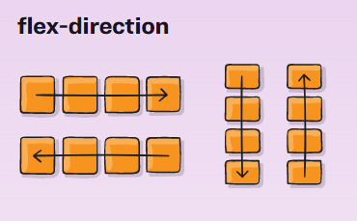
FlexBox: Direction
.flex-row { flex-direction: row; }
.flex-row-reverse { flex-direction: row-reverse; }
.flex-column { flex-direction: column; }
.flex-column-reverse { flex-direction: column-reverse; }
Sources
https://getbootstrap.com/docs/4.5/utilities/flex/#direction
https://css-tricks.com/snippets/css/a-guide-to-flexbox/

Slide 34
FlexBox: Direction with Breakpoints
flex-{breakpoint}-{direction}
Example
class="d-flex flex-column flex-lg-row"
Vertical FlexBox on Extra Small, Small, and Medium screens.
Horizontal FlexBox on Large and Extra Large screens.
Name | Abbreviation | Viewport Width
Extra Small | xs | ≥ 0px
Small | sm | ≥ 576px
Medium | md | ≥ 768px
Large | lg | ≥ 992px
Extra Large | xl | ≥ 1200px
Sources
https://getbootstrap.com/docs/4.5/utilities/flex/#direction
https://css-tricks.com/snippets/css/a-guide-to-flexbox/

Slide 35
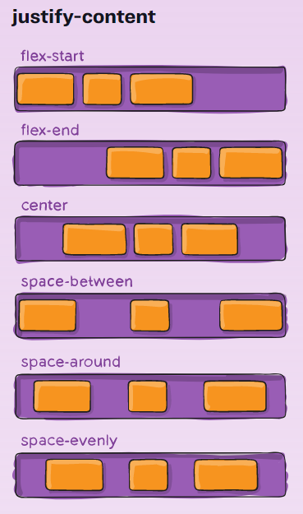
FlexBox: Justify Content
justify-content-start
justify-content-end
justify-content-center
justify-content-between
justify-content-around
justify-content-evenly
justify-content-{breakpoint}-{justify}
Sources
https://getbootstrap.com/docs/4.5/utilities/flex/#justify-content
https://css-tricks.com/snippets/css/a-guide-to-flexbox/
https://github.com/twbs/bootstrap/issues/24862

Slide 36
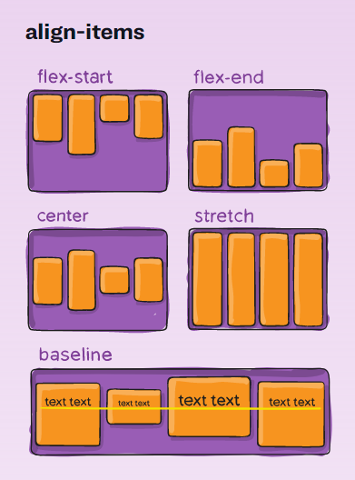
FlexBox: Align Items
align-items-start
align-items-end
align-items-center
align-items-stretch
align-items-baseline
align-items-{breakpoint}-{align}
Sources
https://getbootstrap.com/docs/4.5/utilities/flex/#align-items
https://css-tricks.com/snippets/css/a-guide-to-flexbox/

Slide 37
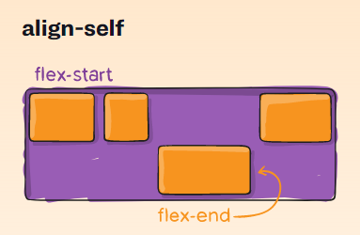
FlexBox: Align Self
align-self-start
align-self-end
align-self-center
align-self-stretch
align-self-baseline
align-self-{breakpoint}-{align}
Sources
https://getbootstrap.com/docs/4.5/utilities/flex/#align-self
https://css-tricks.com/snippets/css/a-guide-to-flexbox/

Slide 38
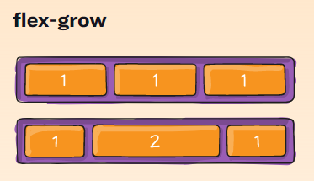
FlexBox: Grow & Shrink
flex-grow-0
flex-grow-1
flex-shrink-0
flex-shrink-1
flex-{breakpoint}-{grow|shrink}-{0|1}
Sources
https://getbootstrap.com/docs/4.5/utilities/flex/#grow-and-shrink
https://css-tricks.com/snippets/css/a-guide-to-flexbox/

Slide 39
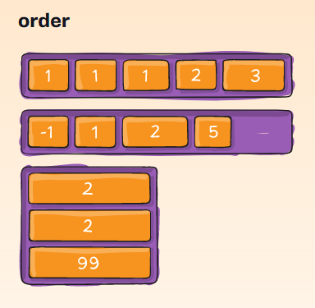
FlexBox: Order
order-0
order-1
order-2
order-3
order-4
order-5
order-6
order-7
order-10
order-11
order-12
order-{breakpoint}-{order}
Sources
https://getbootstrap.com/docs/4.5/utilities/flex/#order
https://css-tricks.com/snippets/css/a-guide-to-flexbox/

Slide 40
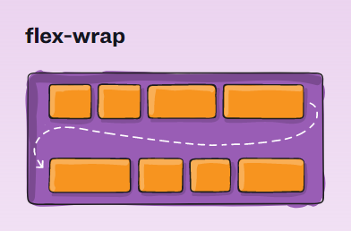
FlexBox: Wrap
flex-nowrap
flex-wrap
flex-wrap-reverse
flex-{breakpoint}-{wrap}
Sources
https://getbootstrap.com/docs/4.5/utilities/flex/#wrap
https://css-tricks.com/snippets/css/a-guide-to-flexbox/

Slide 41
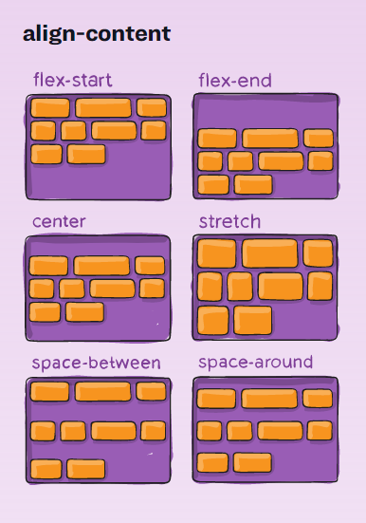
FlexBox: Align Content
Heads Up! This property has no effect on single rows of flex items.
align-content-start
align-content-end
align-content-center
align-content-stretch
align-content-between
align-content-around
align-content-{breakpoint}-{align}
Sources
https://getbootstrap.com/docs/4.5/utilities/flex/#align-content
https://css-tricks.com/snippets/css/a-guide-to-flexbox/

Slide 42
Summary

Slide 43
Topics Covered
History of Bootstrap
Key Benefits of Bootstrap
How to download/install Bootstrap
Breakpoints
Spacing
Sizing
Colors
Text Formatting
FlexBox

